Slide 1
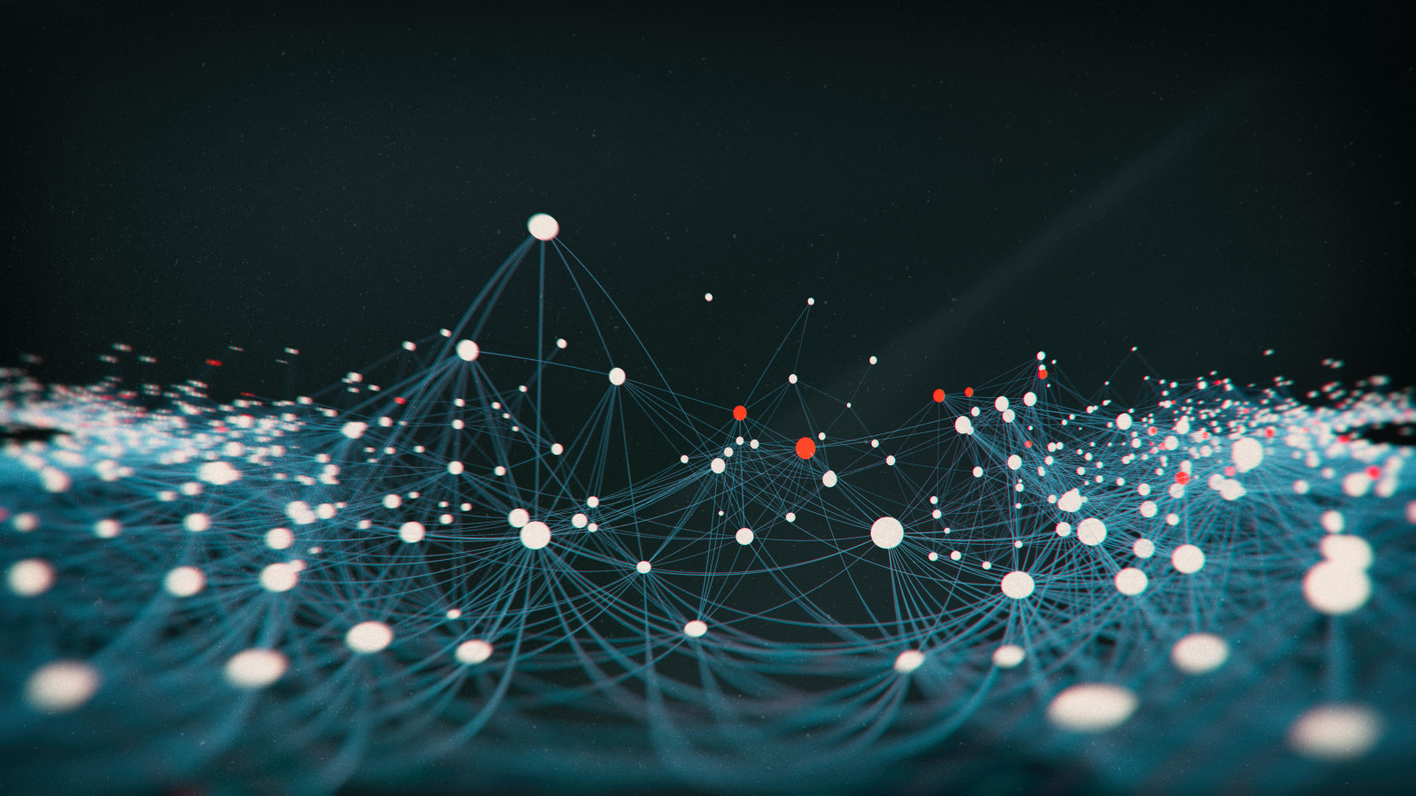

Predictive Networks, Illusions and Schizophrenia
Umar Shaik
Joint work with Antonina Kolokolova (supervisor) , Daniel Power and Hilary Sinclair

Slide 2
Is not this world an illusion? And yet it fools everybody. -- Angela Carter

Slide 3
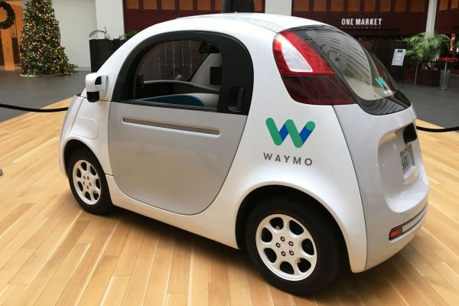

Self Driving Cars
https://waymo.com
Notes:
Is it doing object detection and classification, if it does its too slow and not yet for real time

Slide 4

Action-Conditional Video Prediction in Atari Games
Junhyuk Oh, Xiaoxiao Guo, Honglak Lee, Richard Lewis, Satinder Singh ‘2015
Notes:
RNN and CNN

Slide 5
A
13
4
2
C
D

Slide 6
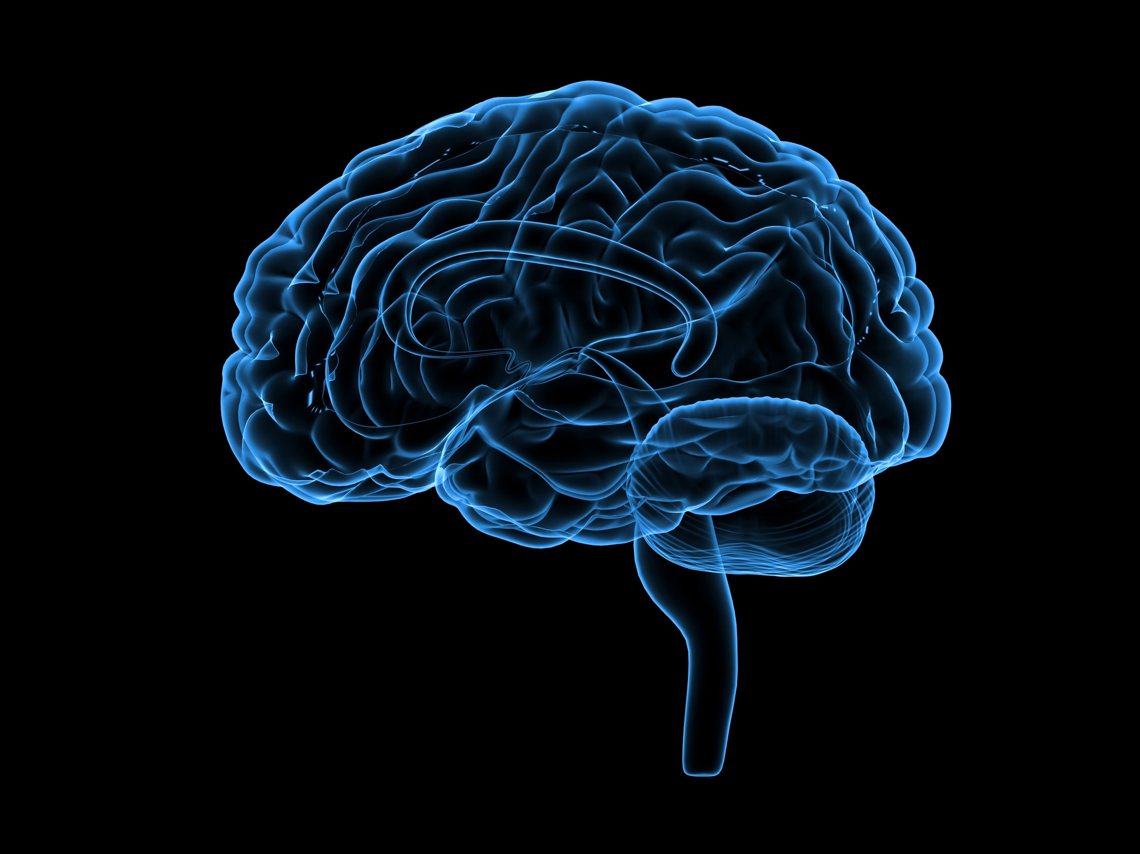

Predictive Coding
Ballard,Rao’99
Reading Text
Reading Numbers
Compute predictions
Compute errors
A
13
C
4
2

Slide 7
PredNet
Bill Lotter, Gabriel Kreiman, and David Cox ‘2016

Slide 8

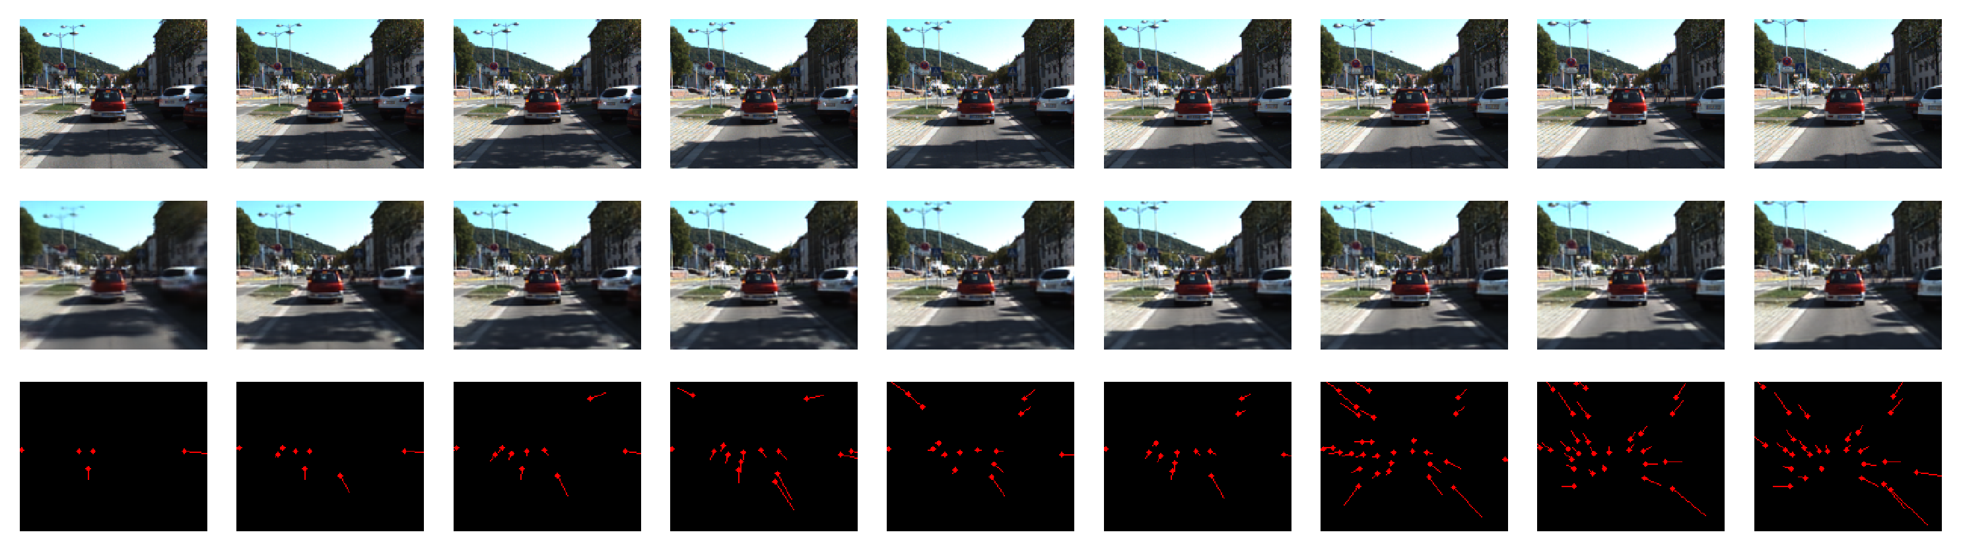
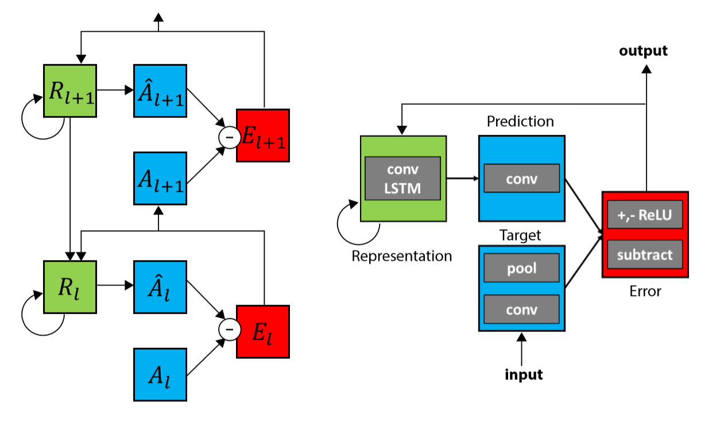
PredNet architecture
Compute predictions
Compute errors
Bill Lotter, Gabriel Kreiman, and David Cox ‘2016

Slide 9
PredNet tries to predict the next frame
Input
Prediction
Flow
Notes:
Prednet is trained on KITTI Dataset

Slide 10
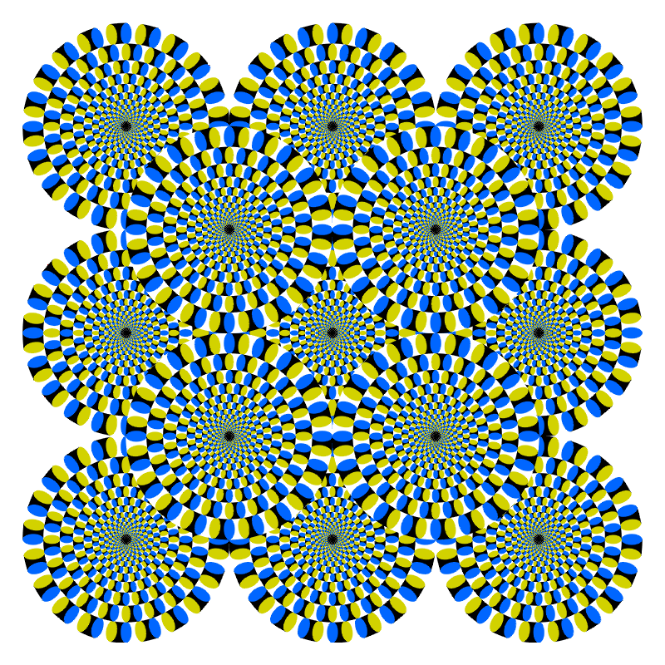

Slide 11
PredNet and Illusions of motion

Slide 12
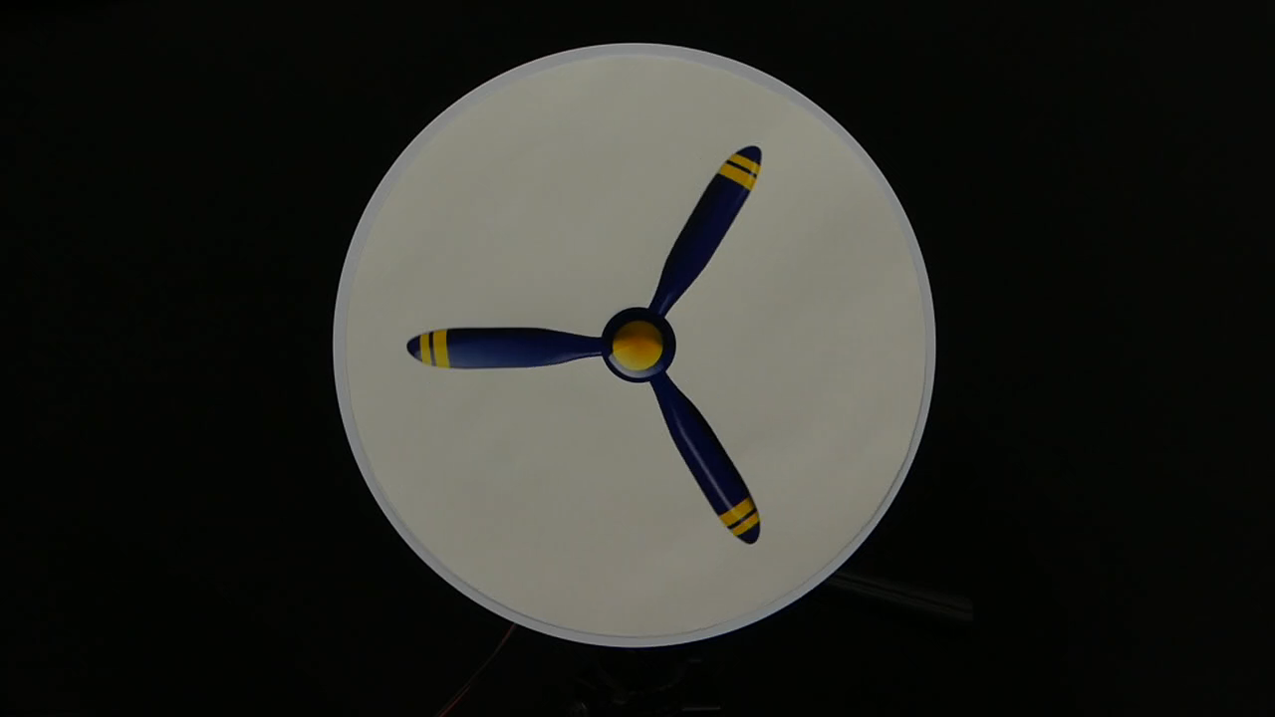
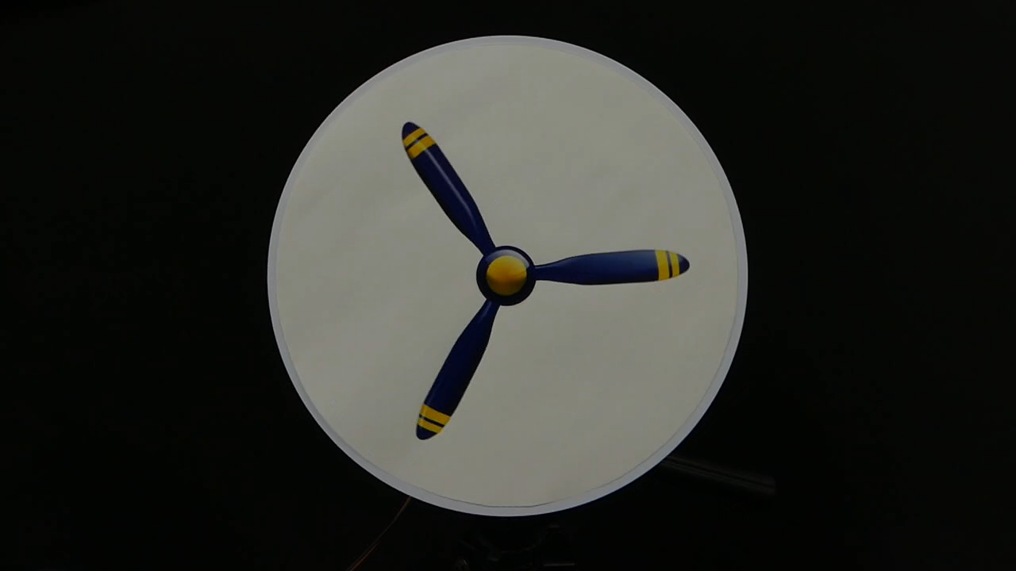
Rotating Propellers
CCW
CW
Eiji Watanabe , Akiyoshi Kitaoka, Kiwako Sakamoto, Masaki Yasugi and Kenta Tanaka ‘2018

Slide 13
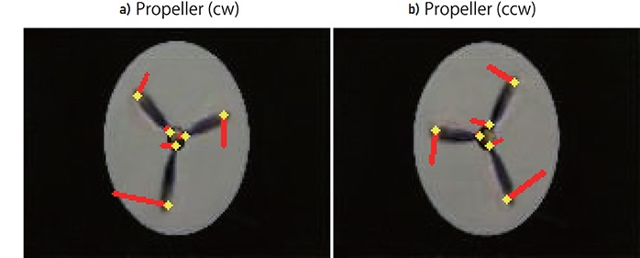
Rotating Propellers Results
Eiji Watanabe , Akiyoshi Kitaoka, Kiwako Sakamoto, Masaki Yasugi and Kenta Tanaka ‘2018
Notes:
Explain Optical Flow Vectors

Slide 14
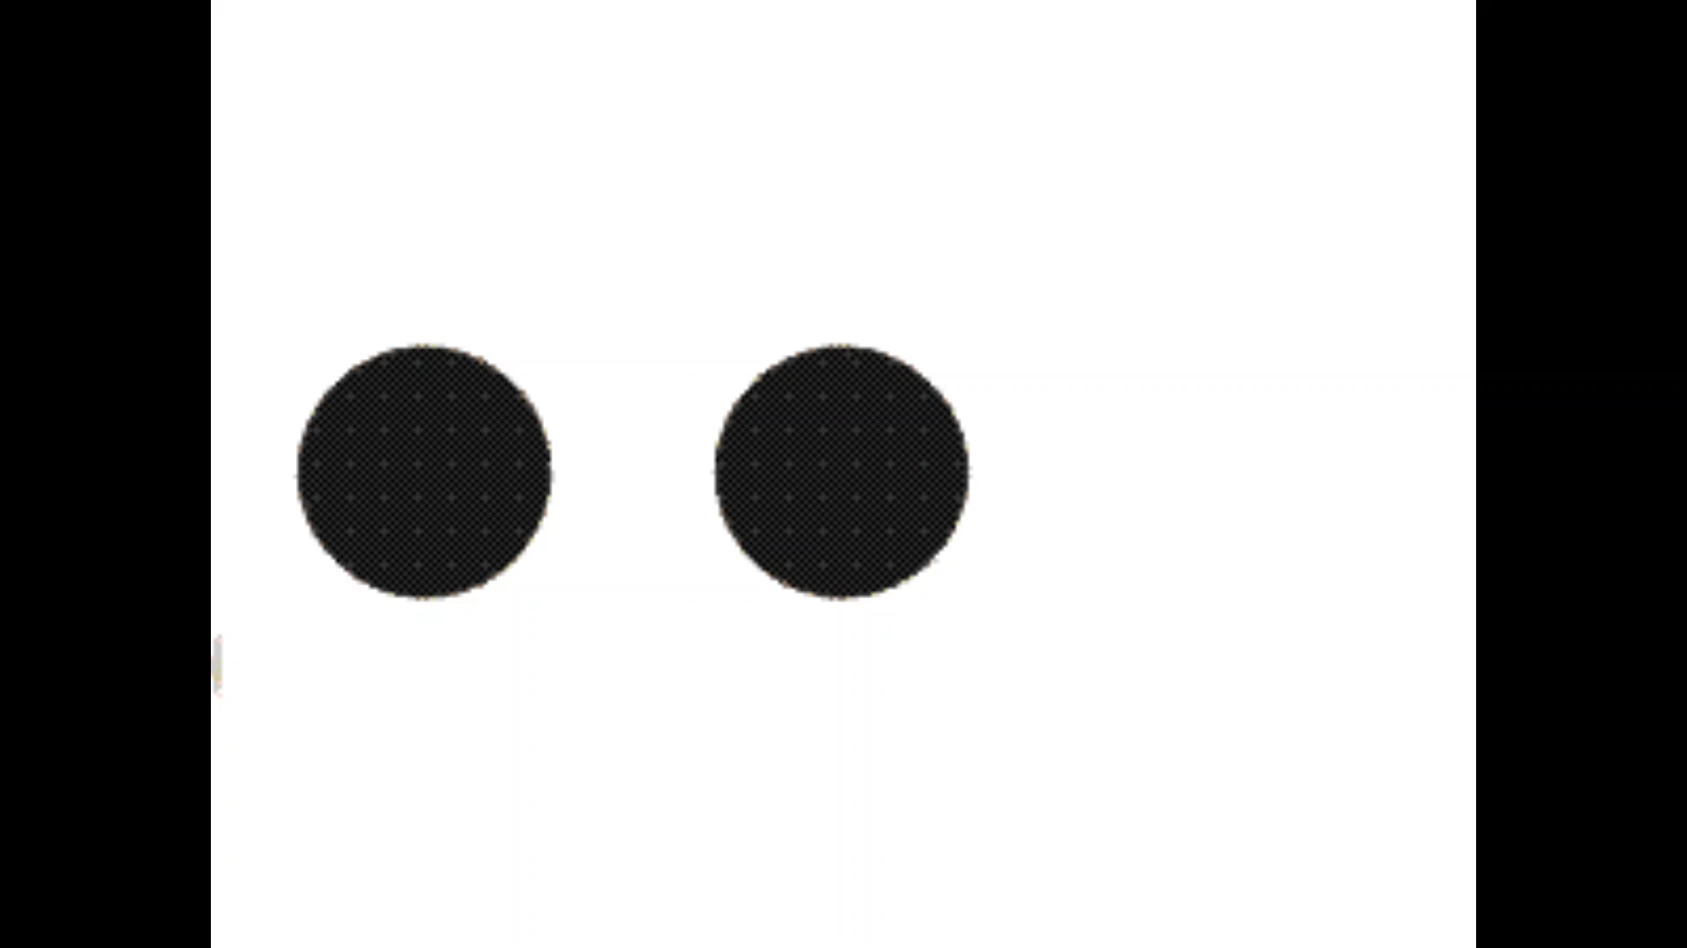
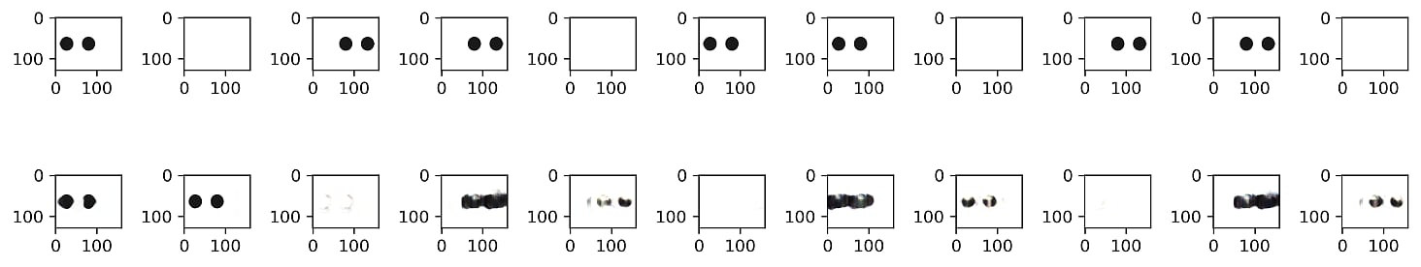
PredNet predicts motion in illusions

Slide 15
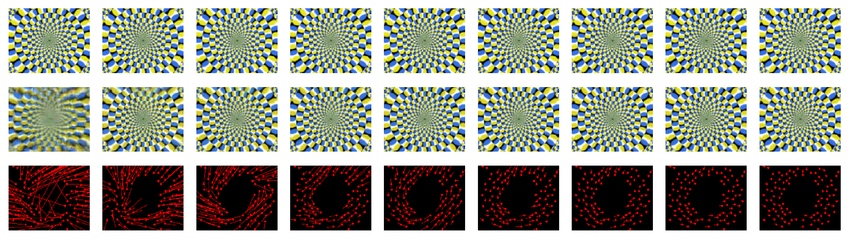
PredNet predicts motion in illusions
Input
Prediction
Flow

Slide 16
PredNet predicts motion in illusions

Slide 17
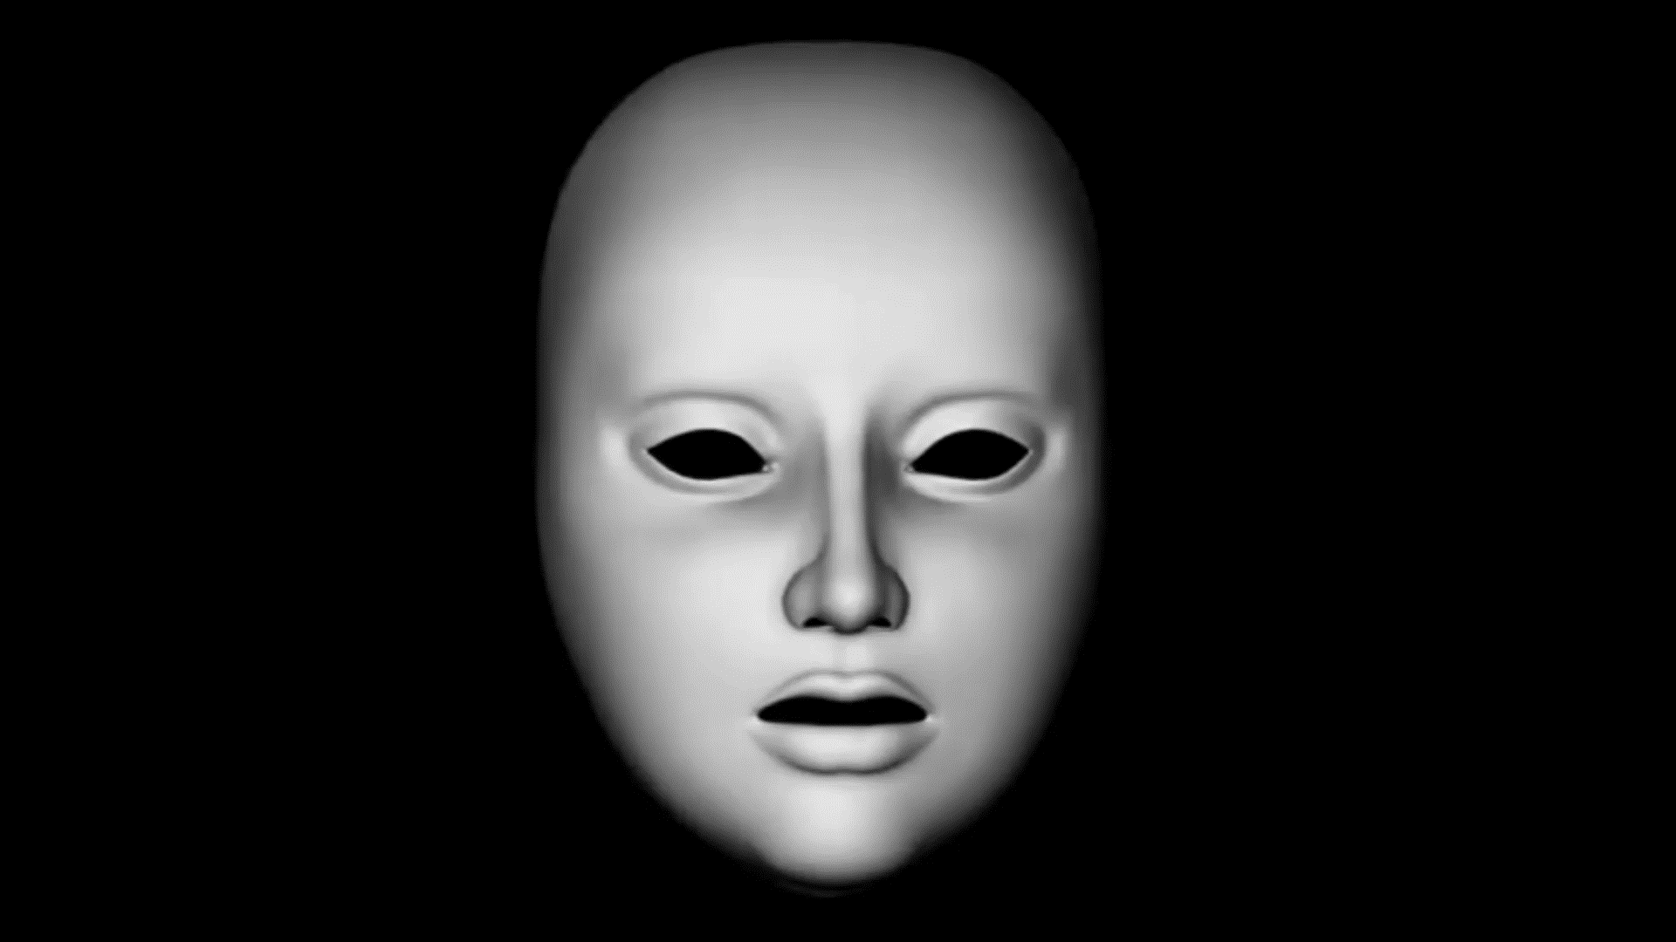
Models of perception in schizophrenia
Prediction error
[ Fletcher, Frith’2009, Adams, Stephan, Brown, Frith, Friston’ 2013, etc]
Precision-weighted prediction coding
Disrupted efference copies
[Pynn, DeSouza’2012]
Mistake results of own actions as external
Circular inference
[Denève, Jardri ‘2013, 2016]
Sensory messages “reverberate” through the network

Slide 18
Model Changes and Results

Slide 19
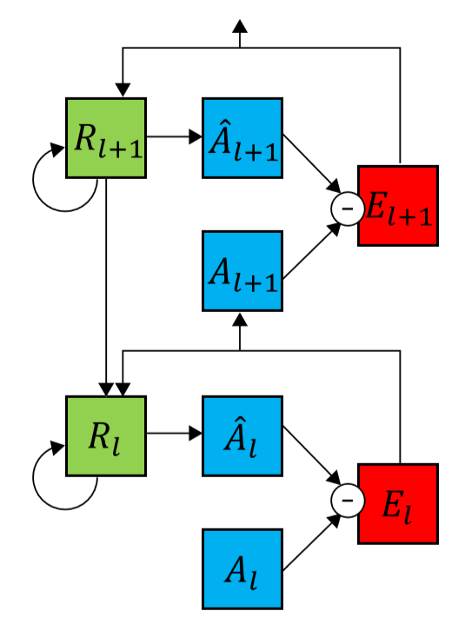
Changes to Model
Forget (some) Top-down Prediction
Error Modification
Forget (some) Prediction
Mix Top-down Prediction
with Input
Mix Prediction with Input

Slide 20
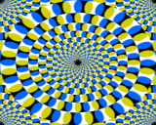
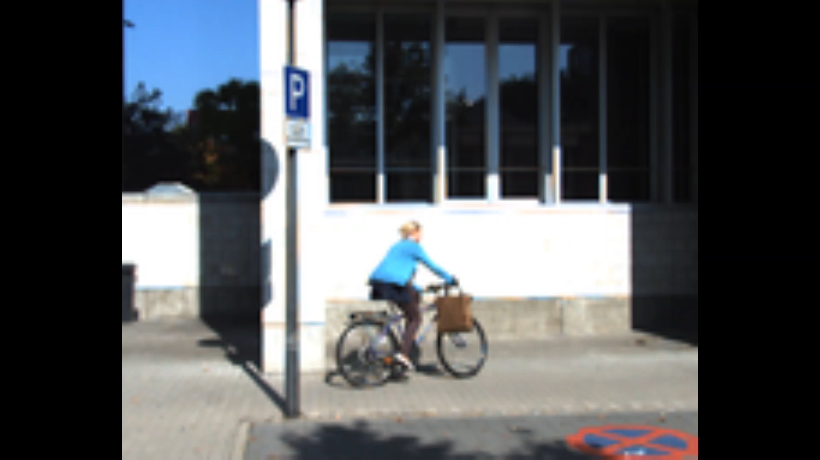
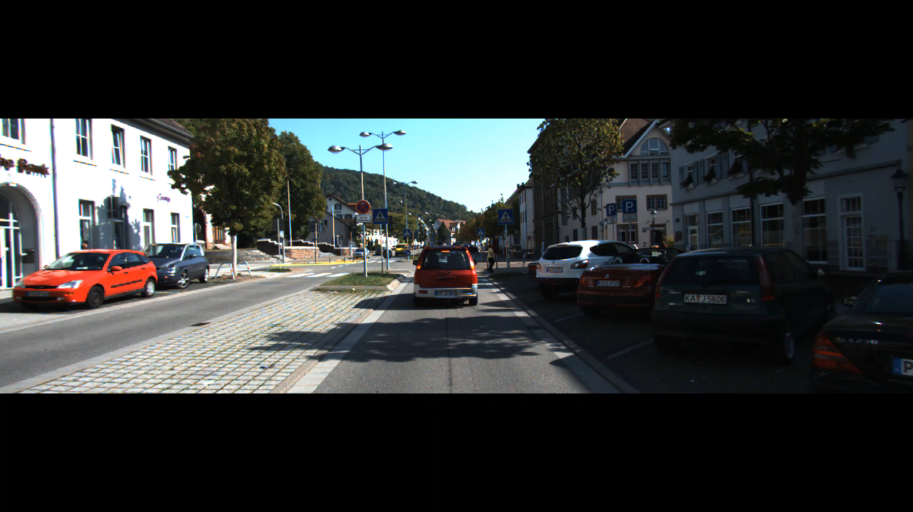
Illusions
Real
Snake
Bike
Snake2
Drive

Slide 21
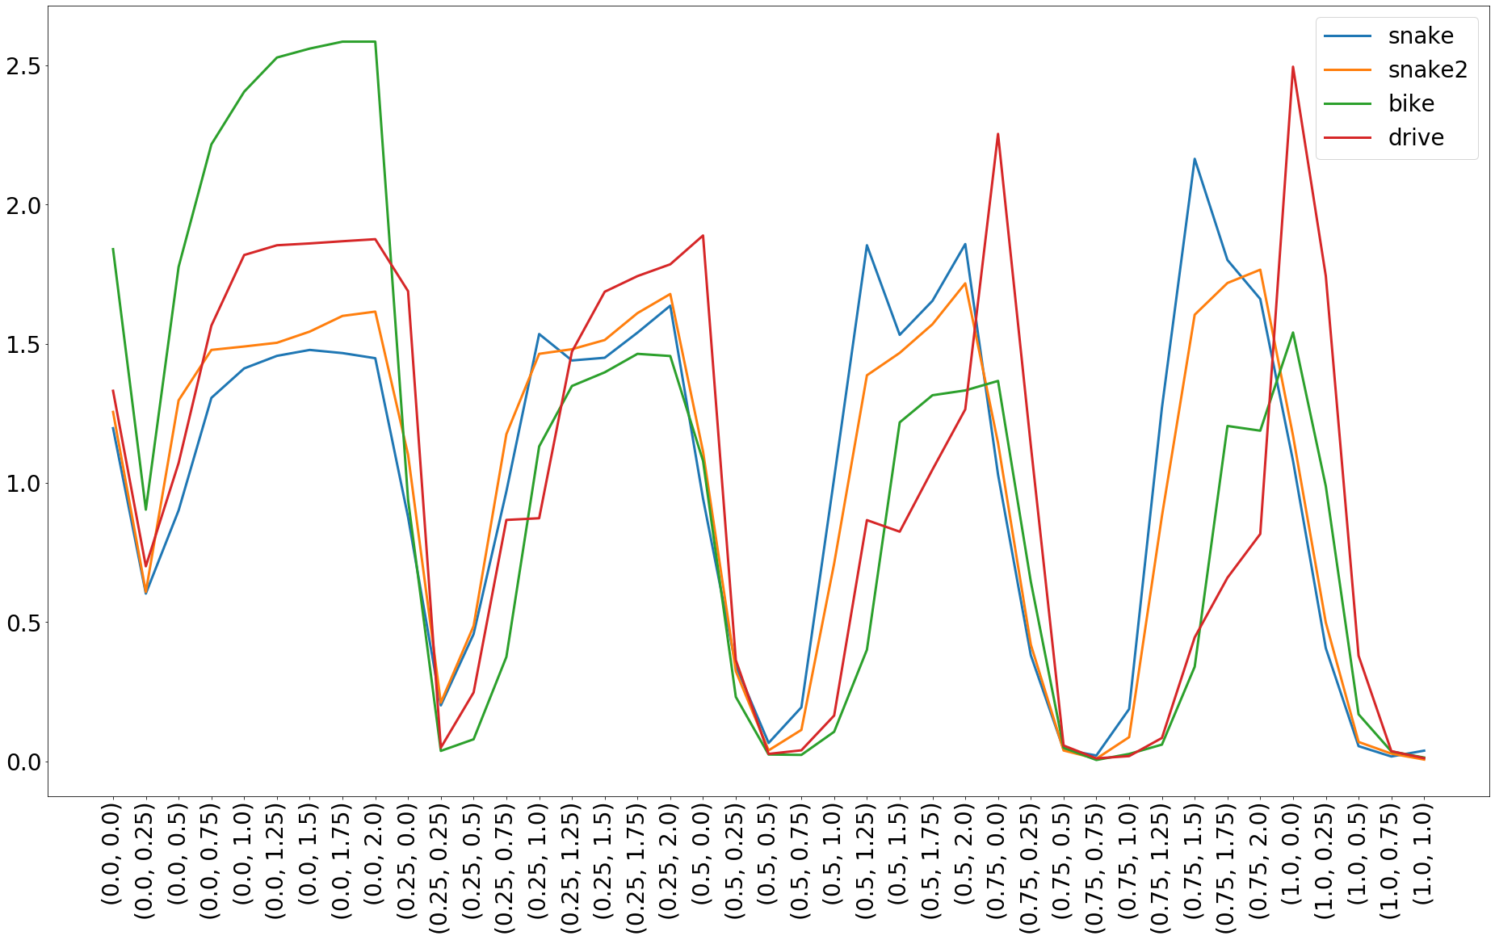
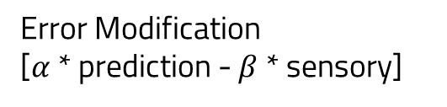

Error Modification
[$α$ * prediction - $β$ * sensory]
Difference between predicted and actual motion
($α,β$)

Slide 22
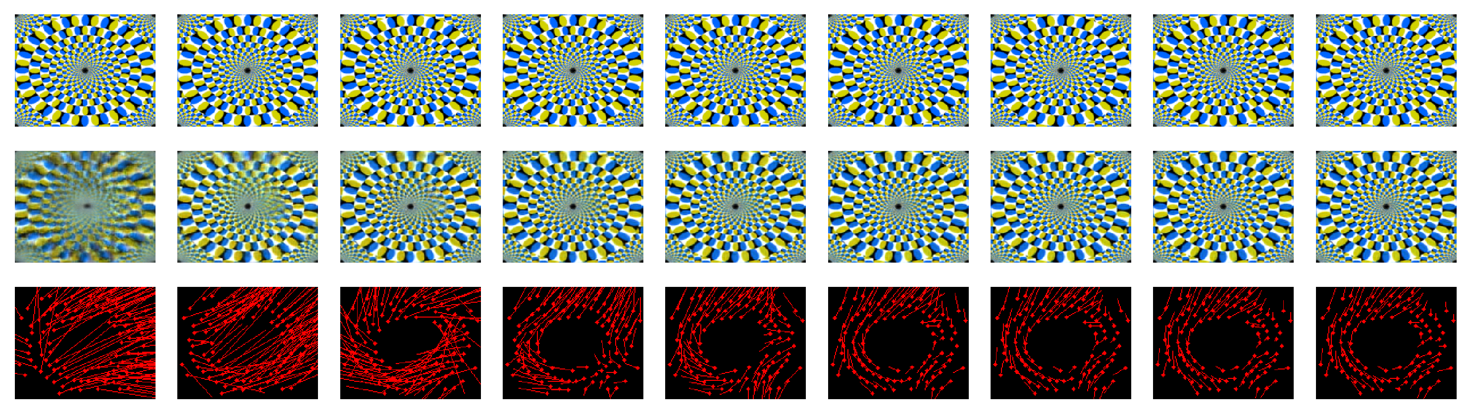
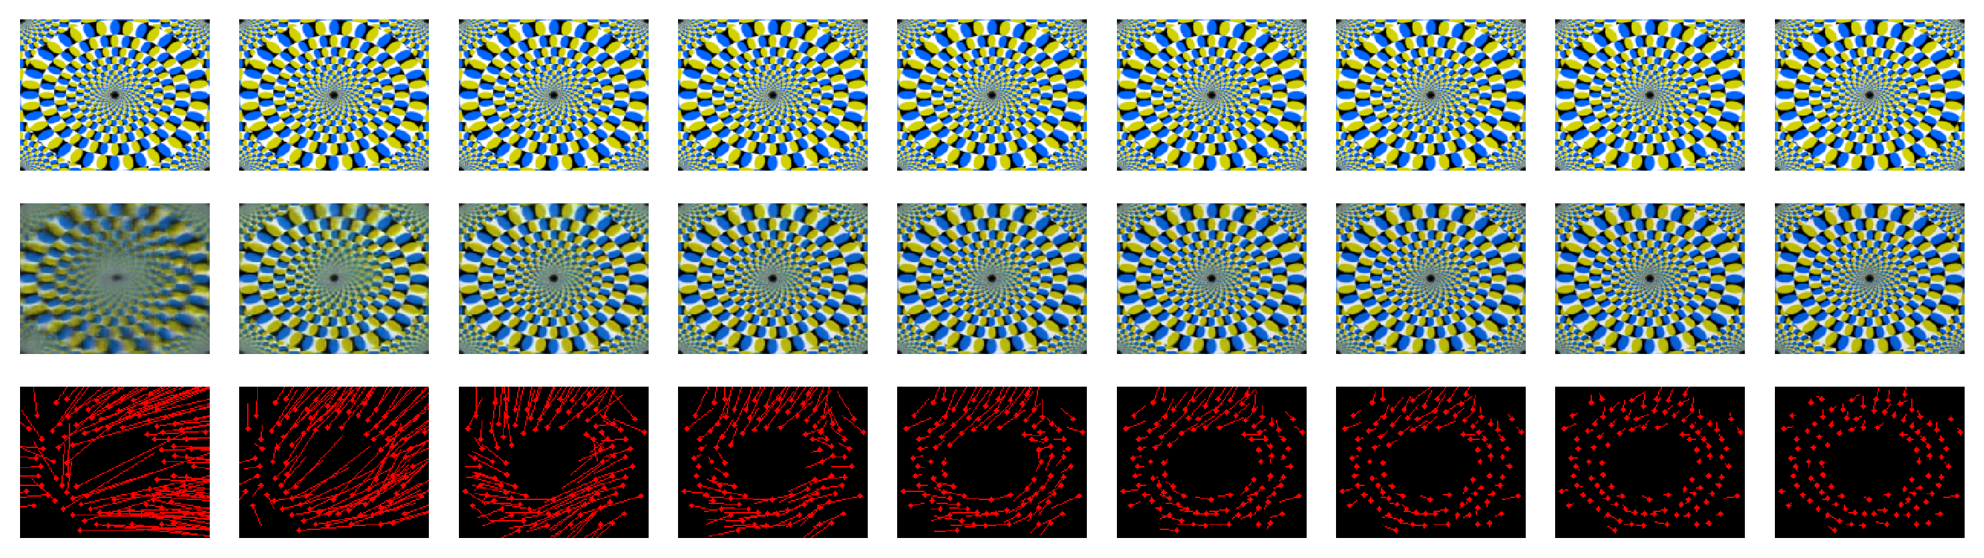




When $α>β,$(more weight on prediction), less illusory motion: “more prediction in error”
Original image (input)
Prediction
$$α=1, β=1$$
Flow
$$α=1, β=1$$
Prediction
$$α=0.95, β=0.85$$
Flow
$$α=0.95, β=0.85$$
Formula Bar : $E_{l}=(α\hat{A_{l}}−βA_{l})$; $(βA_{l }−α\hat{A_{l}})$
Notes:
Add formulas at the bottom

Slide 23
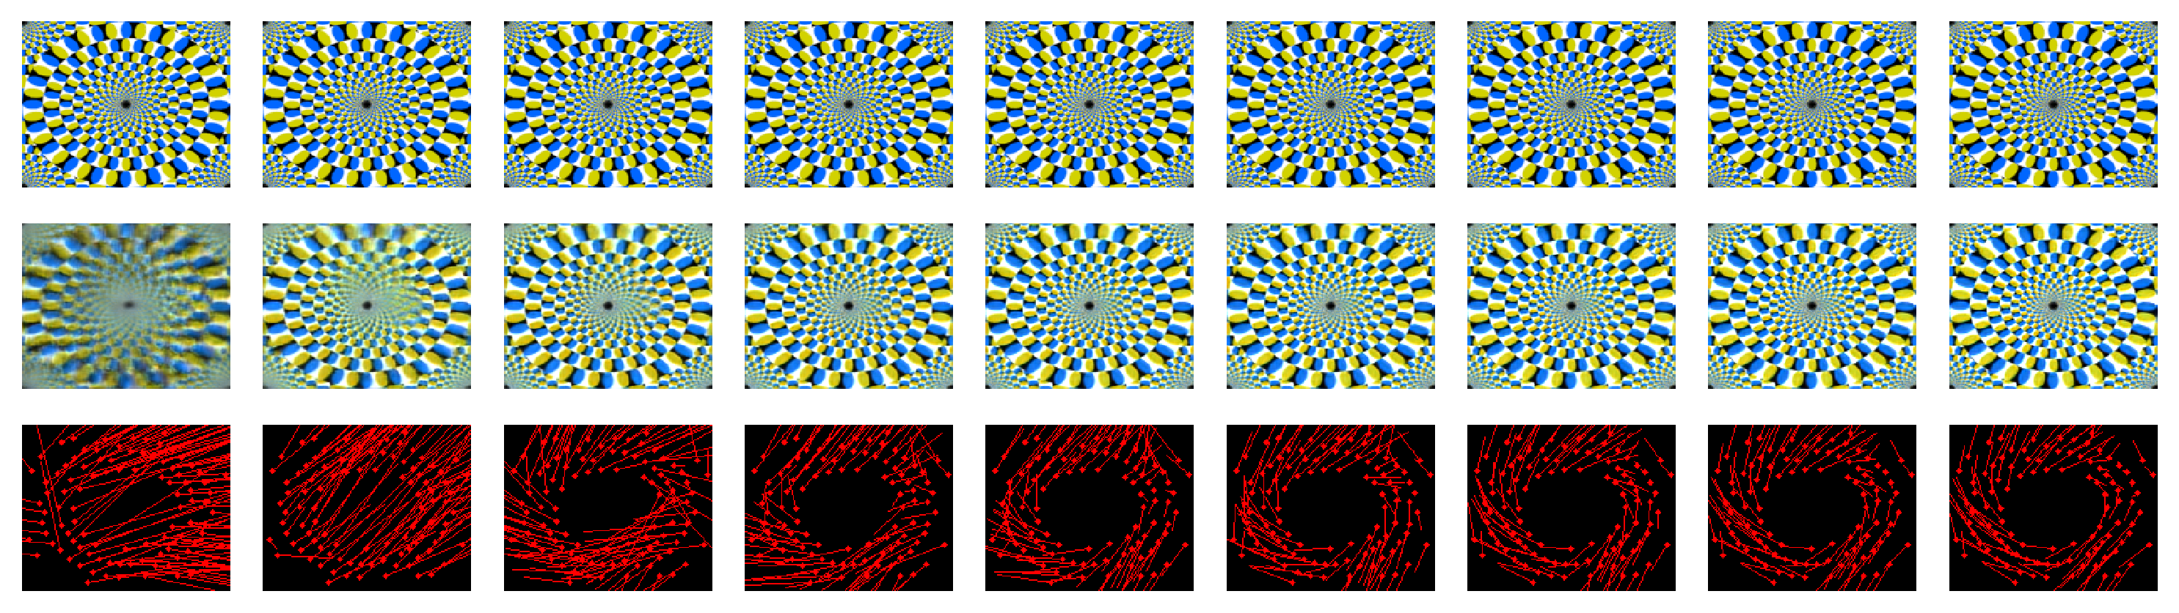


When $β>α,$(more weight on input), more illusory motion: “more input in error”
Original image (input)
Prediction
$$α=1, β=1$$
Flow
$$α=1, β=1$$
Prediction
$$α=0.85, β=0.95$$
Flow
$$α=0.85, β=0.95$$
Formula Bar : $E_{l}=(α\hat{A_{l}}−βA_{l})$; $(βA_{l }−α\hat{A_{l}})$

Slide 24
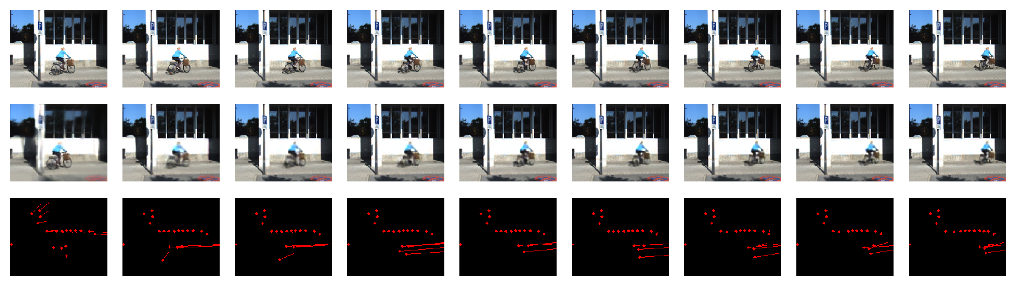
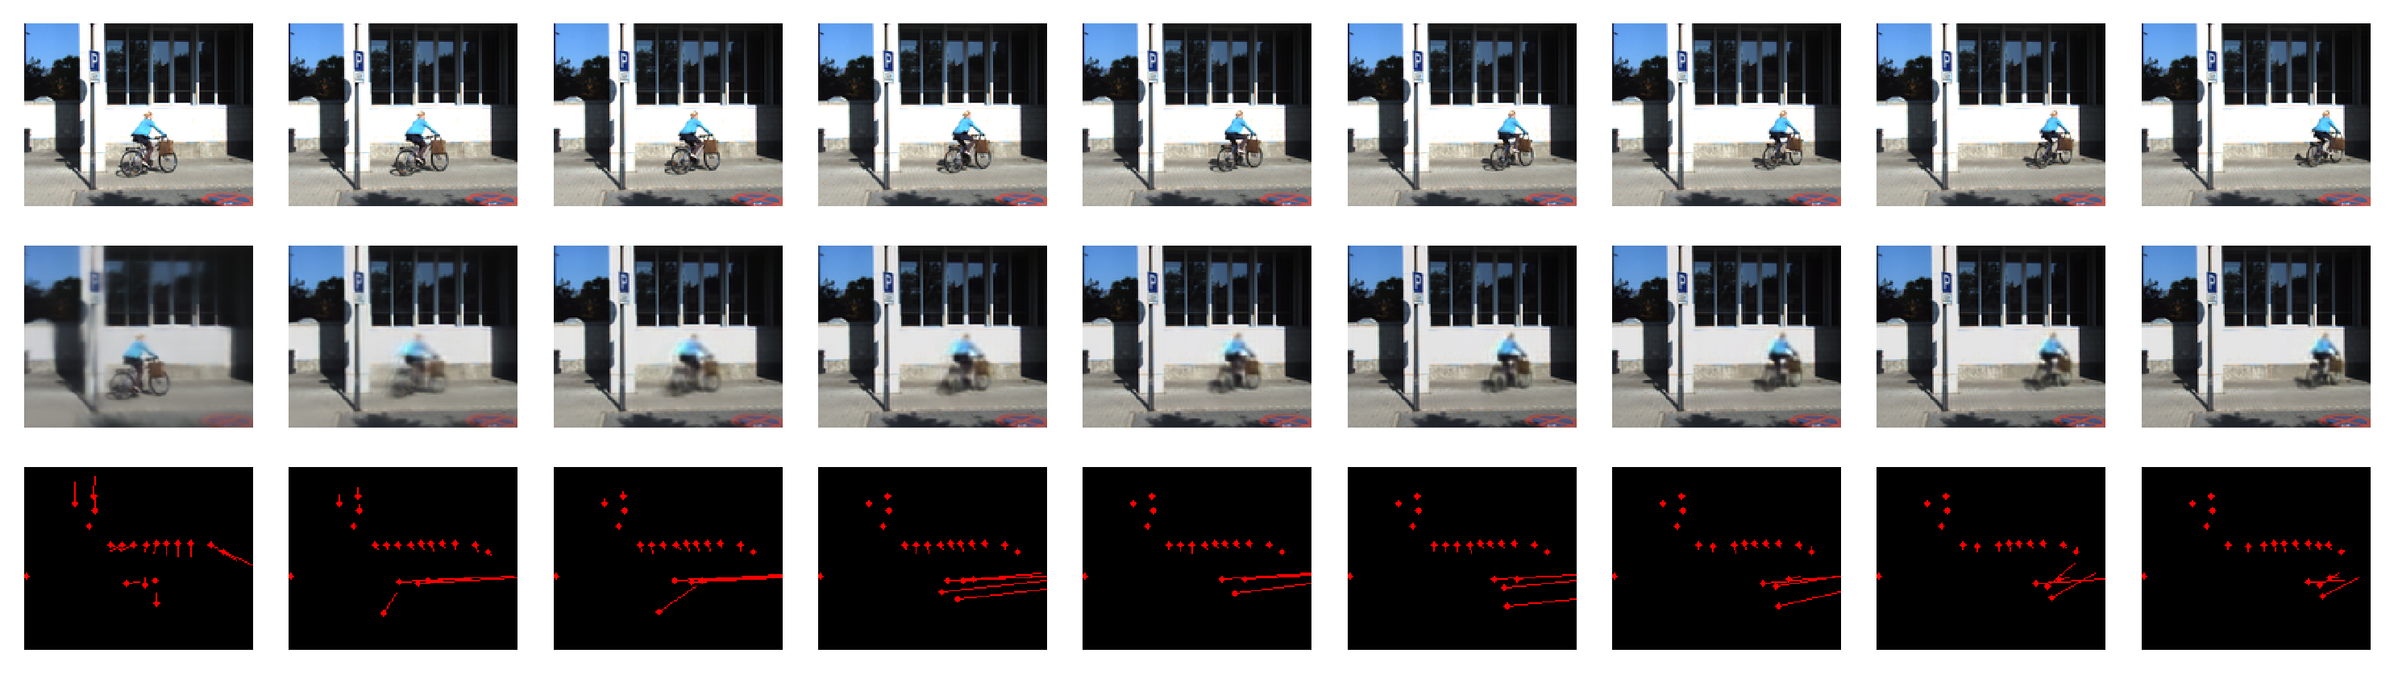


When $α>β,$(more weight on prediction), less illusory motion: “more prediction in error”
Original image (input)
Prediction
$$α=1, β=1$$
Flow
$$α=1, β=1$$
Prediction
$$α=0.95, β=0.85$$
Flow
$$α=0.95, β=0.85$$
Formula Bar : $E_{l}=(α\hat{A_{l}}−βA_{l})$; $(βA_{l }−α\hat{A_{l}})$
Notes:
Direction of the windows is not quite right

Slide 25
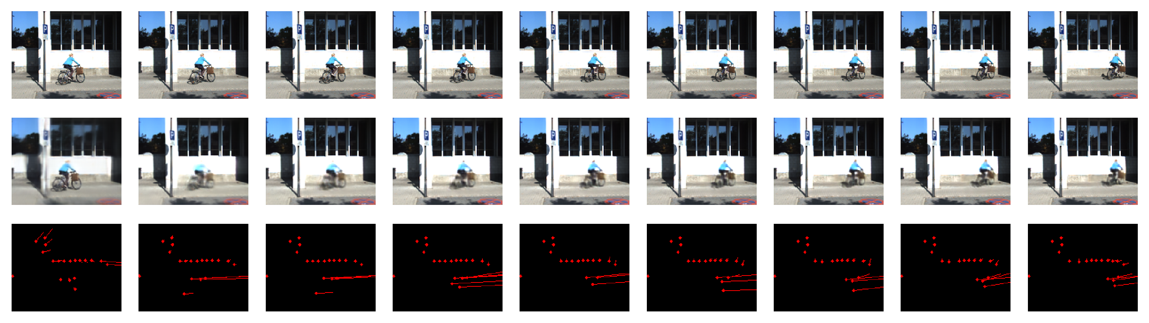



When $β>α,$(more weight on input), more illusory motion: “more input in error”
Original image (input)
Prediction
$$α=1, β=1$$
Flow
$$α=1, β=1$$
Prediction
$$α=0.85, β=0.95$$
Flow
$$α=0.85, β=0.95$$
Formula Bar : $E_{l}=(α\hat{A_{l}}−βA_{l})$; $(βA_{l }−α\hat{A_{l}})$

Slide 26
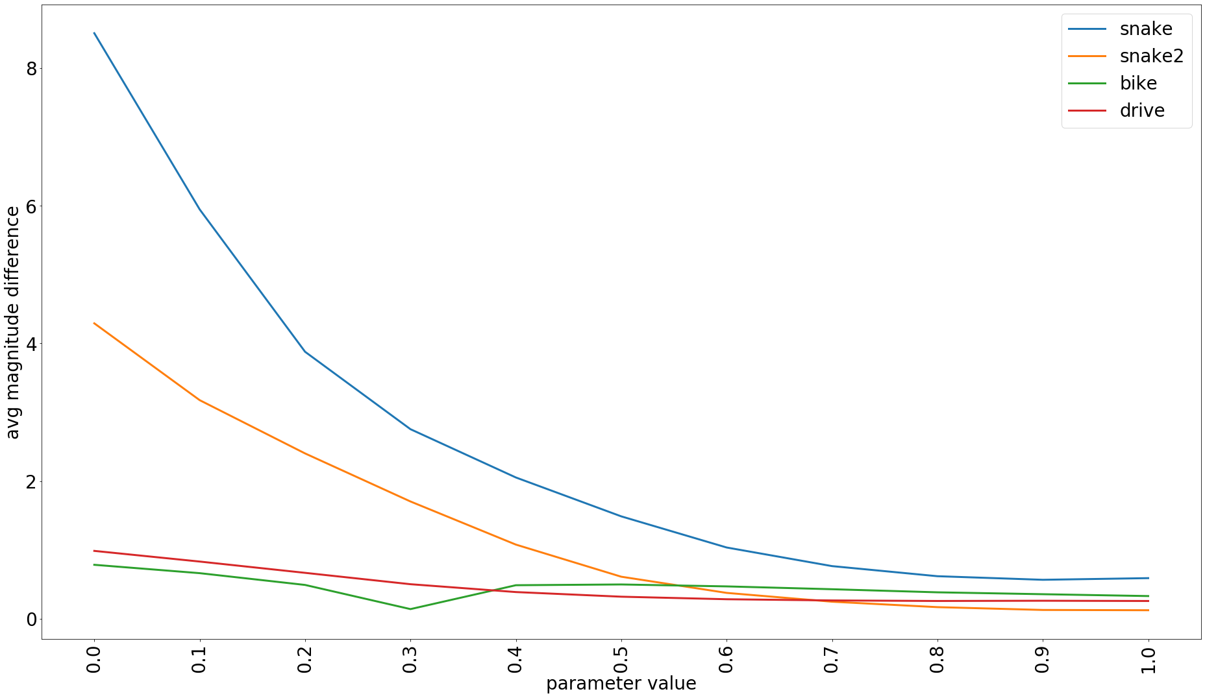

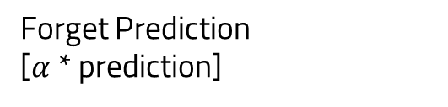
Forget Prediction
[$α$ * prediction]
Difference between predicted and actual motion
($α$)

Slide 27
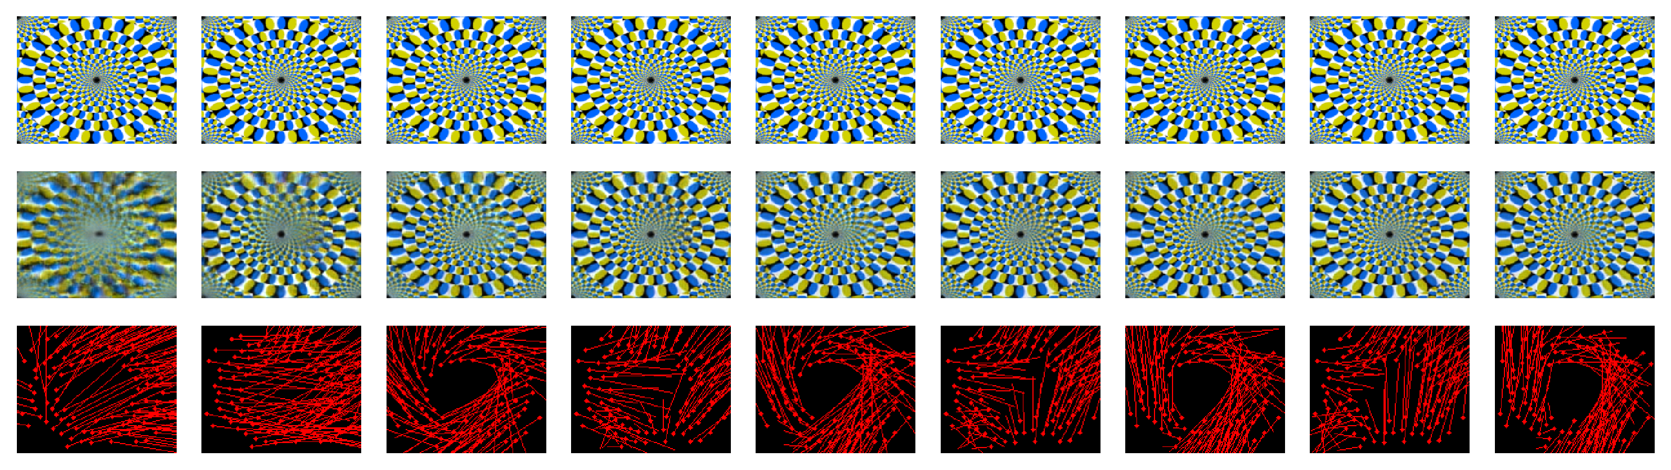
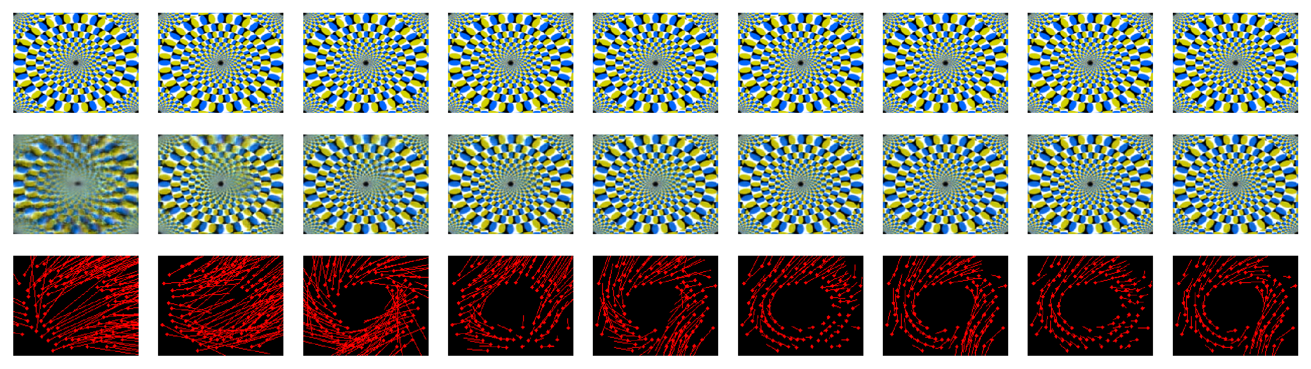





As disruption increases, the illusions have a better sense of direction
Original image (input)
Prediction
$$α=0.25$$
Flow
$$α=0.25$$
Flow
$$α=0.75$$
Flow
$α=1$
Formula Bar: $R_{l}=CLSTM({{αR}_{l}, E}_{l}, up(R_{l+1}))$
Notes:
Add formulas at the bottom

Slide 28
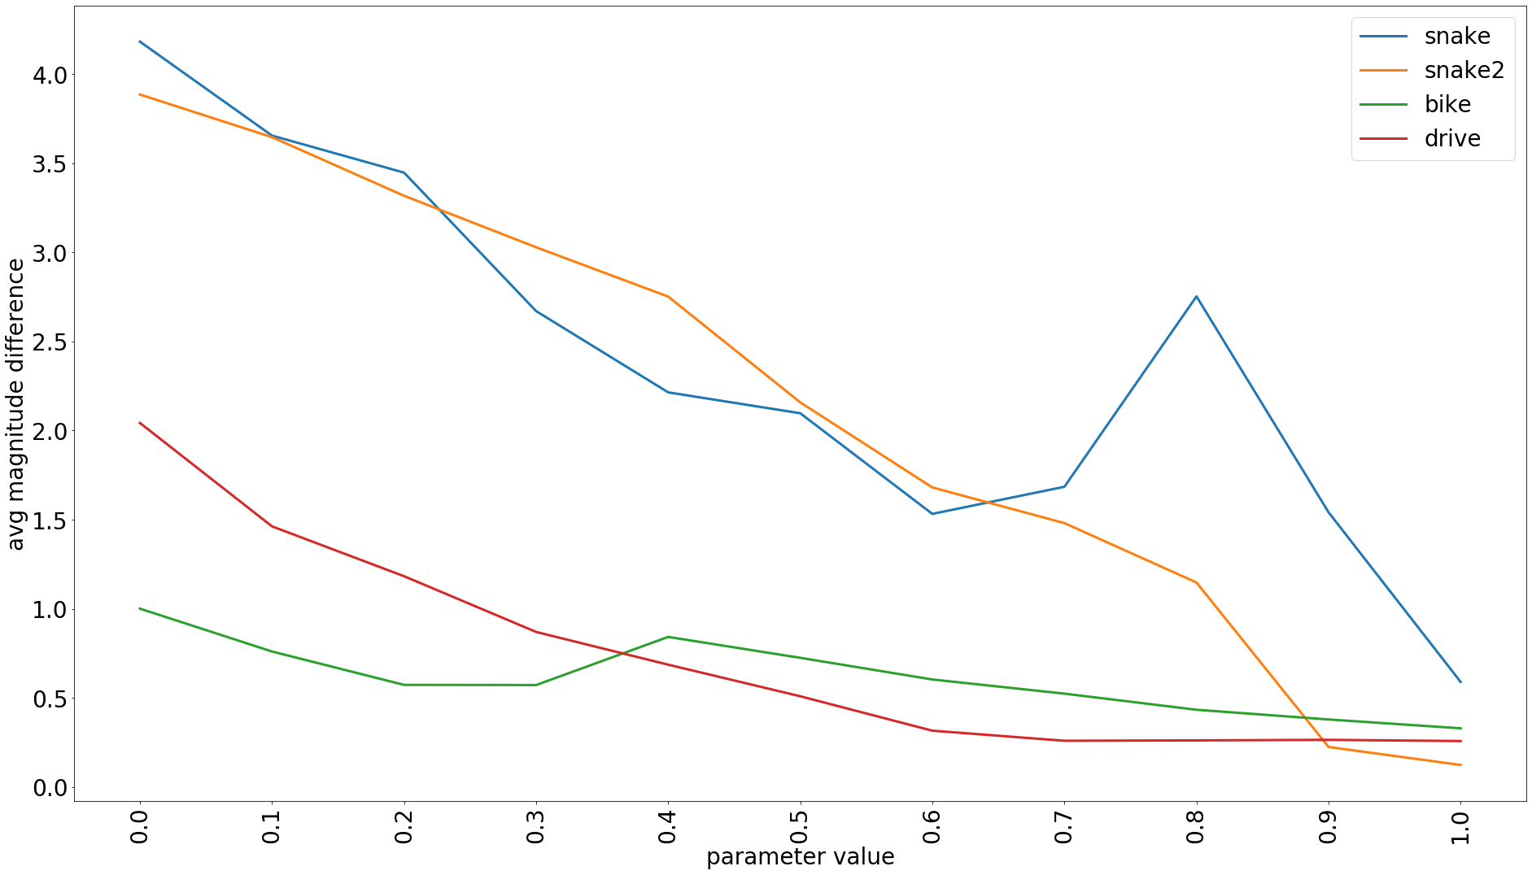
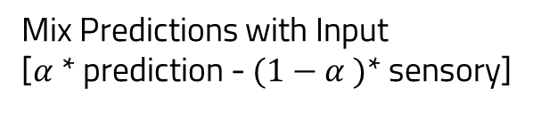
Mix Predictions with Input
[$α$ * prediction - $(1−α )$* sensory]
Difference between predicted and actual motion
($α$)

Slide 30
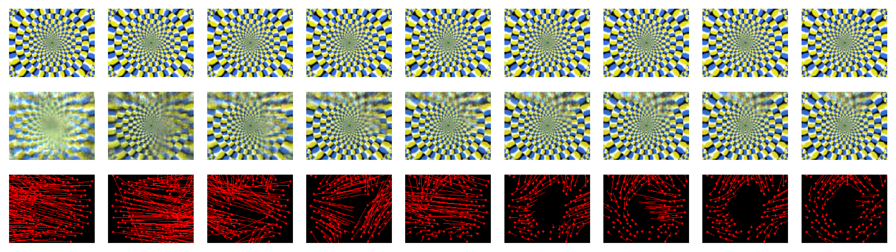
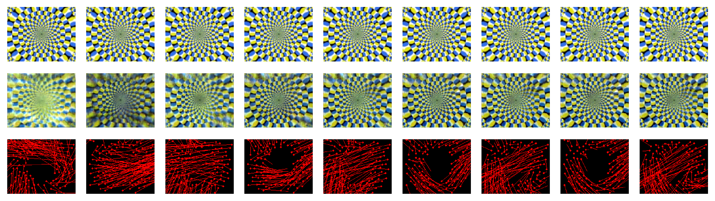



when disruption is greater, “More weight on prediction” – “More stable flow vectors”
Original image (input)
Prediction
$$α=1$$
Flow
Prediction
$$α=0.75$$
Flow
Prediction
$α=0.25$
Flow
Formula Bar: $R_{l}=CLSTM({{αR}_{l}+\left(1−α\right)A_{l}, E}_{l}, up(R_{l+1}))$
Notes:
Directional Changes
We didn’t manage to deconvolve because of the restriction in keras itself

Slide 31
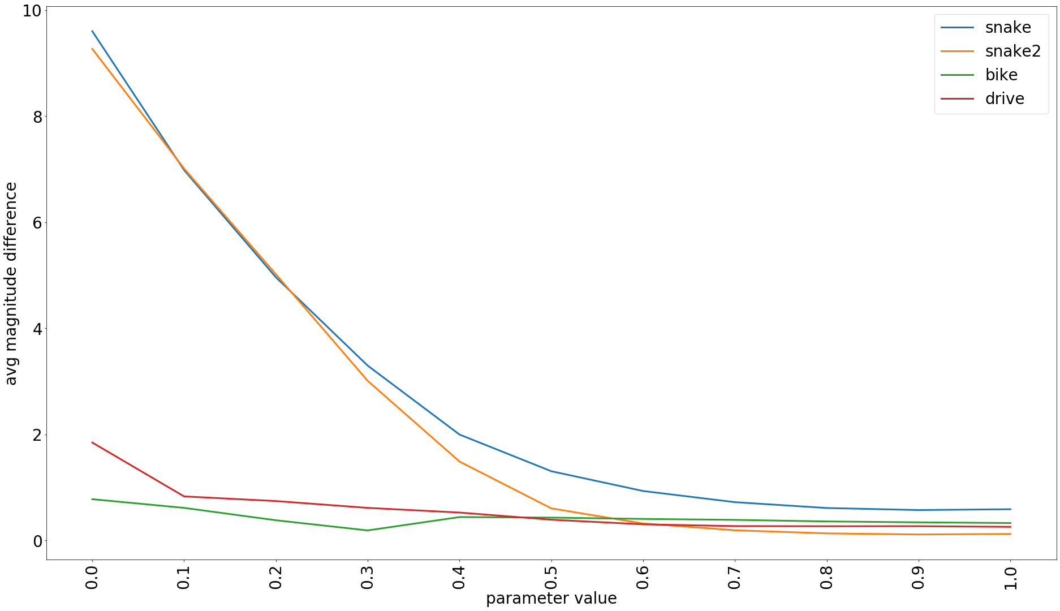

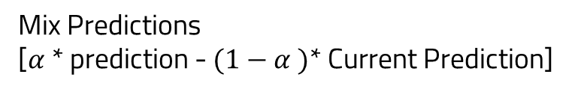
Mix Predictions
[$α$ * prediction - $(1−α )$* Current Prediction]
Difference between predicted and actual motion
($α$)

Slide 32
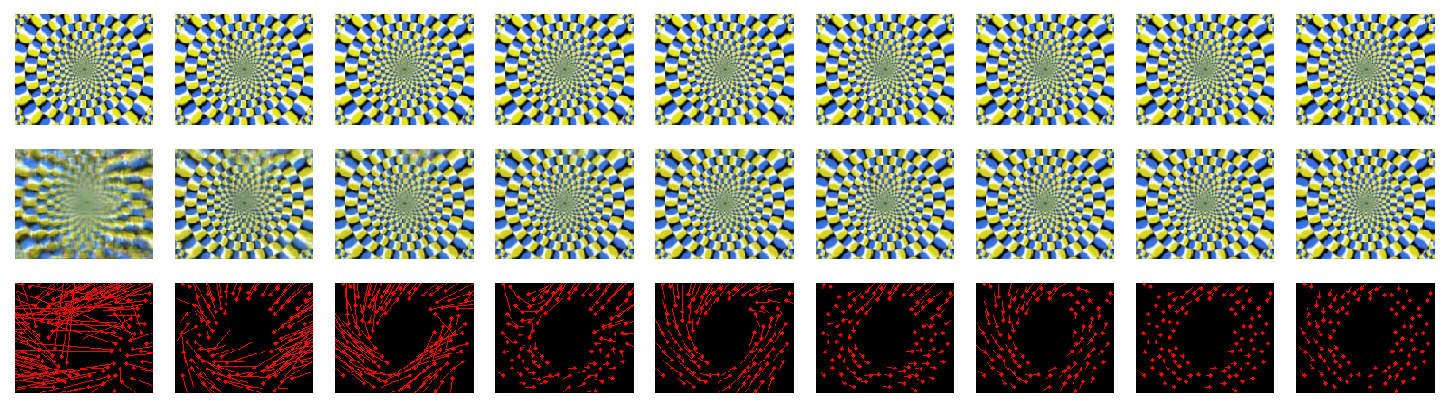
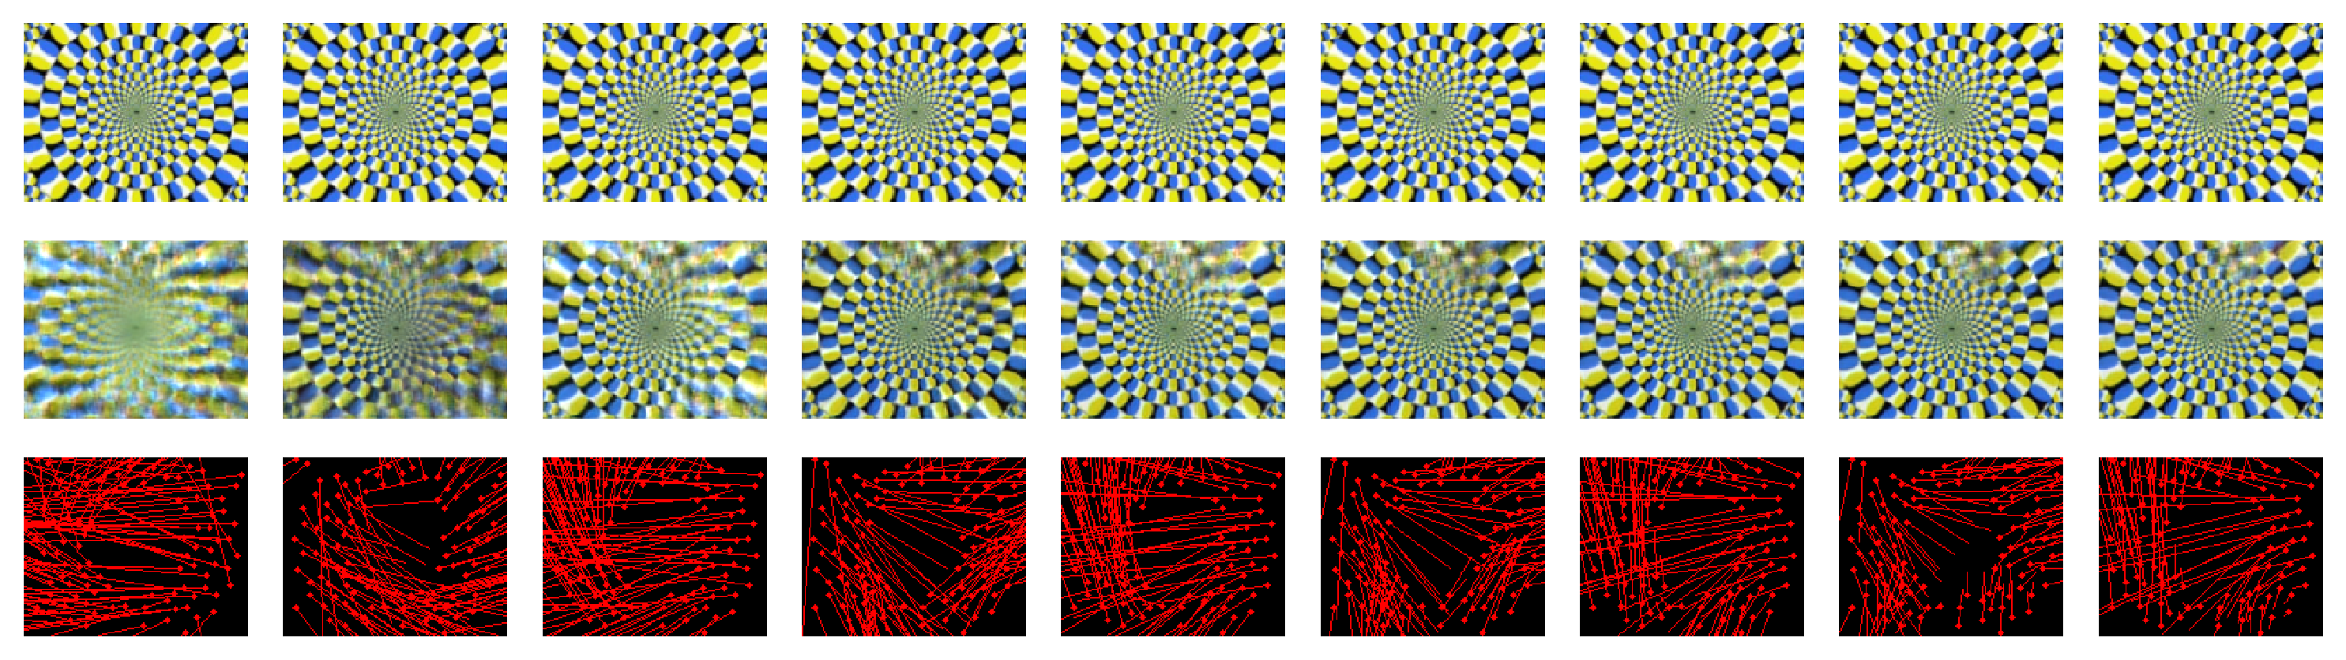





when disruption is less, “More weight on current prediction” – “lesser sense of direction”
Original image (input)
Prediction
$$α=1$$
Flow
$$α=1$$
Prediction
$$α=0.75$$
Flow
$$α=0.75$$
Prediction
$α=0.25$
Flow
$α=0.25$
Formula Bar: ${ R}_{l}=CLSTM({{αR}_{l}+\left(1−α\right){\hat{A}}_{l}, E}_{l}, up(R_{l+1}))$
Notes:
We didn’t manage to deconvolve because of the restriction in keras itself

Slide 33
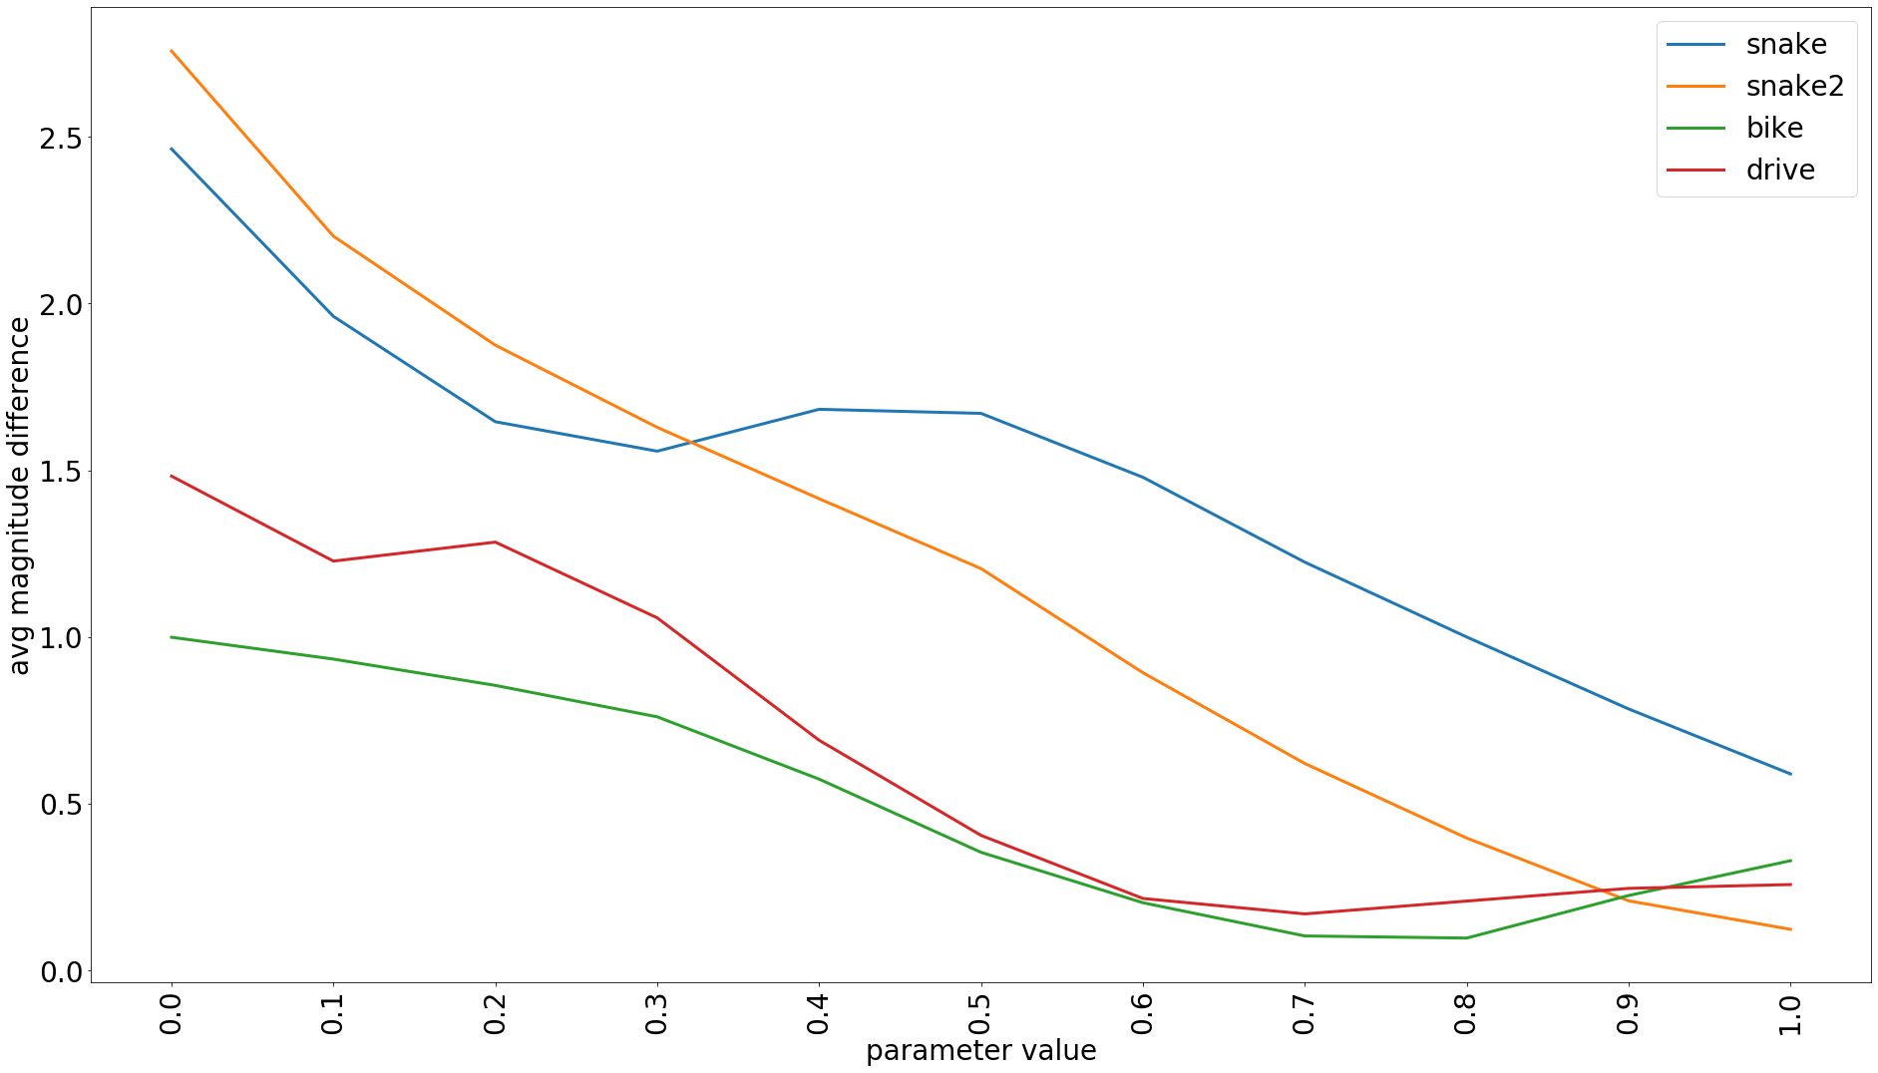
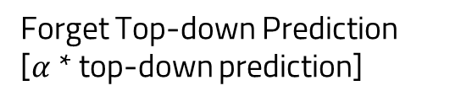
Forget Top-down Prediction
[$α$ * top-down prediction]
Difference between predicted and actual motion
($α$)

Slide 34
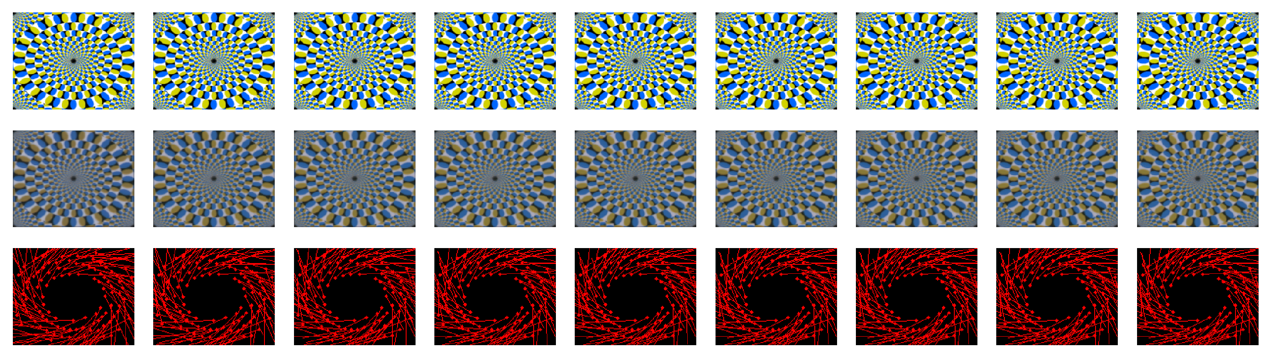
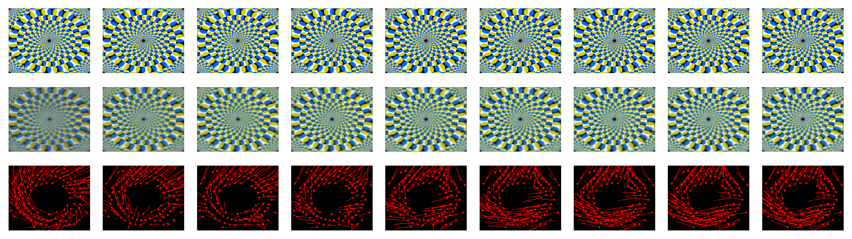







when disruption is lesser, “lesser weight on prediction” – “very strong perceived flow”
Original image (input)
Prediction
$$α=0$$
Flow
$$α=0$$
Prediction
$$α=0.5$$
Flow
$$α=0.5$$
Prediction
$α=1$
Flow
$α=1$
Formula Bar: $R_{l}=CLSTM({R_{l}, E}_{l}, up(αR_{l+1}))$
Notes:
Very strong motion right from the very first frame, what do you think is happening?

Slide 35
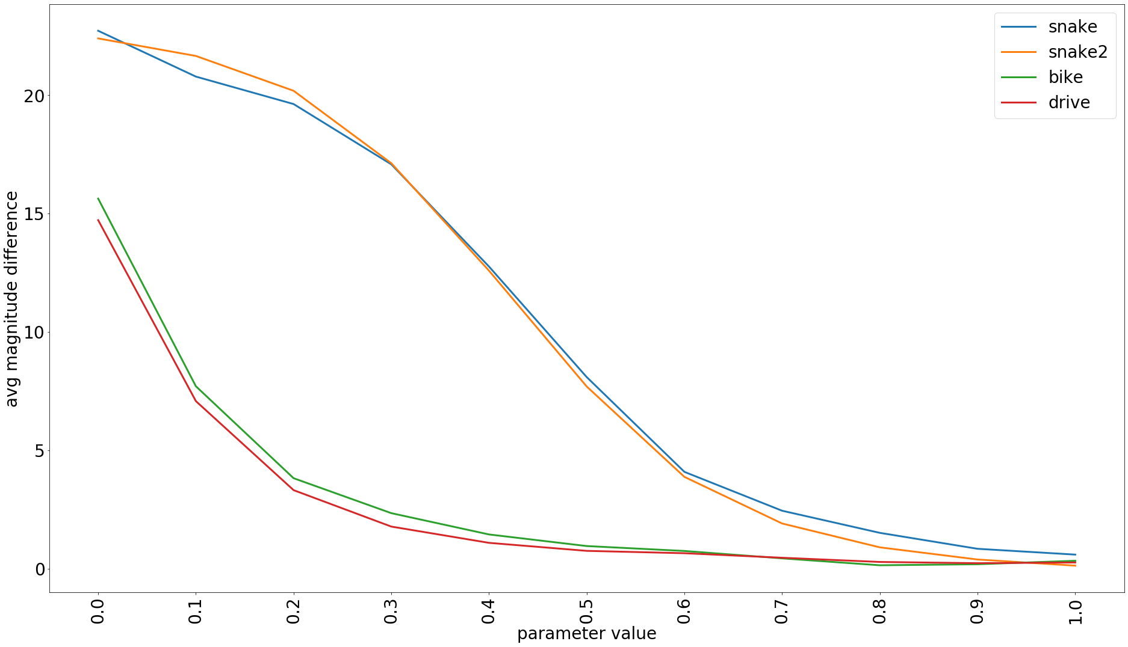
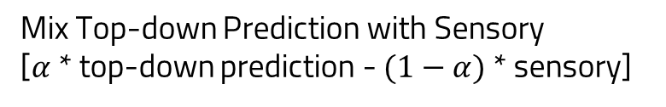
Mix Top-down Prediction with Sensory
[$α$ * top-down prediction - $(1−α)$ * sensory]
Difference between predicted and actual motion
($α$)

Slide 36
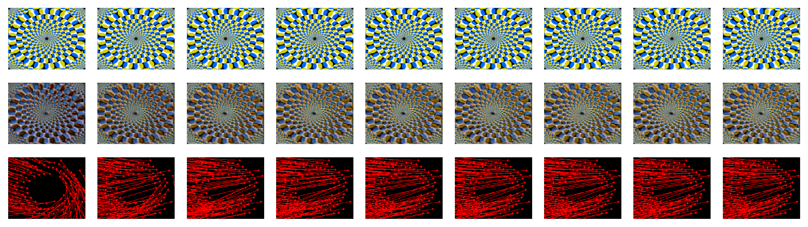
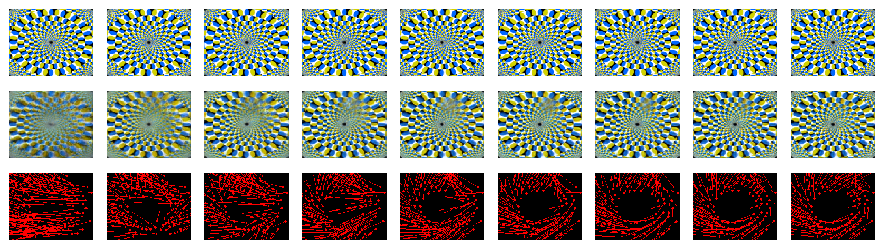




Less disruption, “more weight on input” – “Initial Directional changes and outward flow”
Original image (input)
Prediction
$$α=0.25$$
Flow
$$α=0.25$$
Prediction
$$α=0.75$$
Flow
$$α=0.75$$
Prediction
$α=1$
Flow
$α=1$
Formula Bar: $R_{l}=CLSTM({R_{l}, E}_{l}, up(αR_{l+1}+\left(1−α\right)A_{l}))$
Notes:
Strong opposite direction

Slide 37
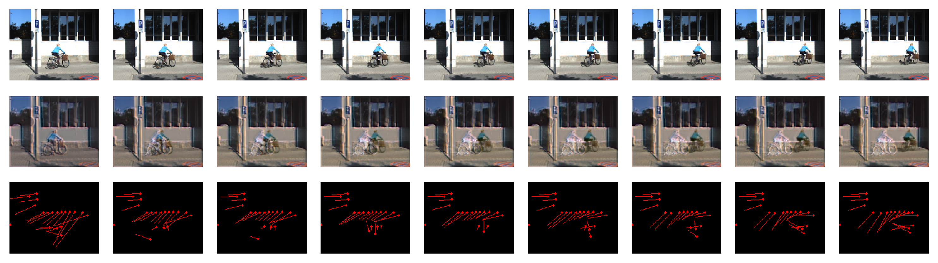
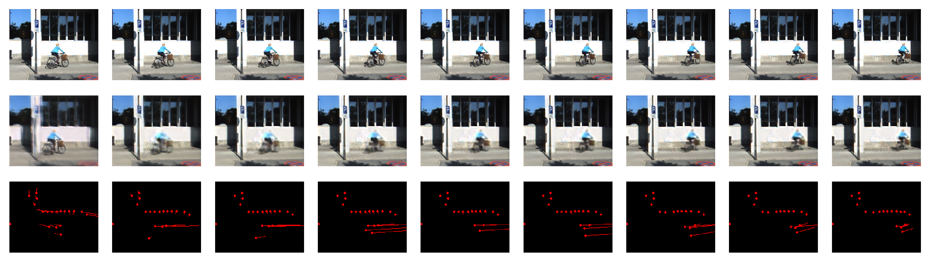




Less disruption, “more weight on input” – “Initial Directional changes and outward flow”
Original image (input)
Prediction
$$α=0.25$$
Flow
$$α=0.25$$
Prediction
$$α=0.75$$
Flow
$$α=0.75$$
Prediction
$α=1$
Flow
$α=1$
Formula Bar: $R_{l}=CLSTM({R_{l}, E}_{l}, up(αR_{l+1}+\left(1−α\right)A_{l}))$
Notes:
Strong opposite direction and ghosting

Slide 38
Conclusion
Forget (some) Top-down Prediction
The error disruption results in the effect of being less susceptible to illusions.
Mixing predictions with sensory results in opposite sense of direction.
Mixing top-down predictions with sensory results in hallucination/Inverted colors.
Forget (some) Prediction
Error Modification
Mix Top-down Prediction
with Input
Mix Prediction with Input

Slide 39
Open Questions ?
What can this say about how brain works and what happens in schizophrenia?
Is there a way to see what happens to confidence/accuracy predictions within PredNet?
Can these results be used to improve predictive networks

Slide 40
THANKS!
Any questions?
You can find me at
ufshaik@mun.ca

Slide 41

Changes to Model
Modify the error, reweighting the prediction and the input:
$E_{l}=(α\hat{A_{l}}−βA_{l})$; $(γA_{l }−δ\hat{A_{l}})$
$E_{l}=(α\hat{A_{l}}−βA_{l})$; $(βA_{l }−α\hat{A_{l}})$
“Forget” (some of) the current prediction when calling LSTM:
$R_{l}=CLSTM({{αR}_{l}, E}_{l}, up(R_{l+1}))$
Mix the current prediction with input when calling LSTM:
$R_{l}=CLSTM({{αR}_{l}+\left(1−α\right)A_{l}, E}_{l}, up(R_{l+1}))$

Slide 42
Changes to Model
Forget (some) Top-down Prediction
Error Modification
Forget (some) Prediction
Mix Top-down Prediction
with Input
Mix Prediction with Input

Slide 43

Changes to Model
Mix the representation with prediction when calling LSTM:
$R_{l}=CLSTM({{αR}_{l}+\left(1−α\right){\hat{A}}_{l}, E}_{l}, up(R_{l+1}))$
“Forget” (some of) the prediction during up sample when calling LSTM :
$$R_{l}=CLSTM({R_{l}, E}_{l}, up(αR_{l+1}))$$
Mix the up sampled representation with input when calling LSTM :
$R_{l}=CLSTM({R_{l}, E}_{l}, up({αR}_{l+1}+\left(1−α\right)A_{l}))$

Slide 44

$$R_{l}^{t}=CLSTM (E_{l}^{t−1},R_{l}^{t−1},$$
$$upsample(R_{l+1}^{t}))$$
$$E_{l}^{t}=[ReLU(A_{l}^{t}−{\hat{A}}_{l}^{t});$$
$$ReLU({\hat{A}}_{l}^{t}−A_{l}^{t})]$$
Notes:
A = Maxpool(ReLU(CONV(E l-1))), else 0
Ahat = conv(R)

Slide 45
PredNet architecture (from Lotter, Kreiman & Cox)
Compute predictions
Compute errors

